Slide 1
North America Excavator Market Share
Wk 5 - Team: Final Project [due Mon] Nathan Burnham, Lisaette Hernton, David Conrad, RD Hall DSC/330 June 30th. 2021 Dr. Lisa Hatherill, DM/IST, MBA, Pmp

Slide 2
Agenda
Overview of YENGST ASSOCIATION
Excavator Specific Analysis
Historical Sales and Projections
Independent Data Analyst
2016 – 2020 Volume by OEM
Industry Headwinds/Tailwinds
Market Disrupters
Competitive Advantages of Smaller Players

Slide 3

YENGST ASSOCIATES

Slide 4
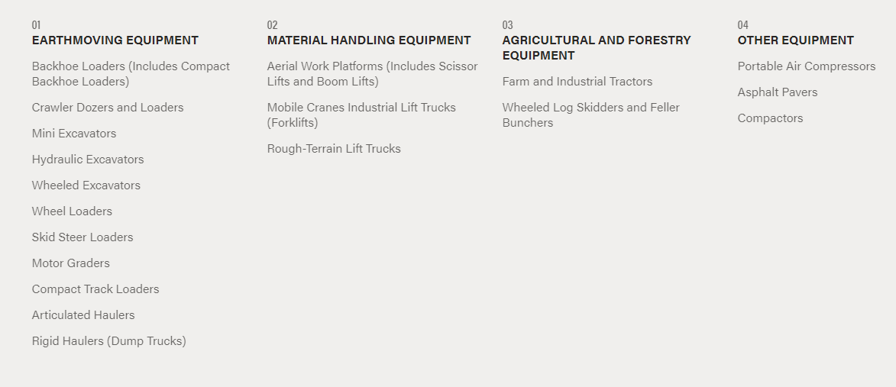
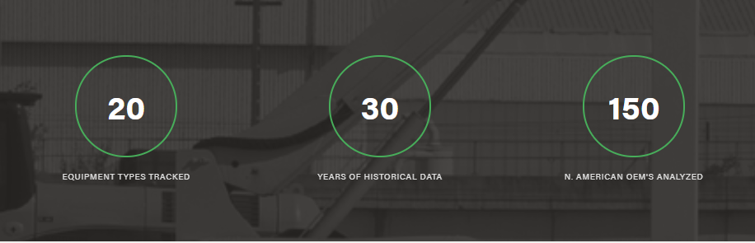
North American Database

Slide 5
Hydraulic Excavator Analysis
Manufacturer | 2016 | 2017 | 2018 | 2019 | 2020 | 2021 | 2022 | 2023 | 2024 | 2025
Bobcat | 1000 | 1200 | 1275 | 1300 | 900
Case | 1000 | 1150 | 1225 | 1250 | 850
Caterpillar | 6100 | 7100 | 7700 | 7600 | 5200
Doosan | 750 | 850 | 925 | 950 | 660
Deere | 5200 | 6100 | 6600 | 6600 | 4400
Manitou (Gehl / Mustang) | 20 | 25 | 30 | 25 | 20
Hitachi | 625 | 750 | 800 | 810 | 570
Hyundai | 300 | 375 | 400 | 400 | 275
JCB | 50 | 200 | 350 | 335 | 200
Kobelco | 925 | 1100 | 1175 | 1250 | 1000 |  | We need a formal here to project forecast by manufacture based on previous sells - I will work on this tomorrow
Komatsu America | 4650 | 5400 | 5800 | 6000 | 4100
Kubota | 650 | 900 | 1075 | 1150 | 1285
LBX | 775 | 900 | 975 | 1000 | 680
Liebherr | 75 | 115 | 125 | 115 | 80
Sany | 200 | 240 | 260 | 250 | 200
Takeuchi | 90 | 115 | 125 | 125 | 85
Terex Fuchs | 20 | 30 | 20 | 20 | 15
Volvo | 1225 | 1480 | 1775 | 2200 | 1900
Yanmar | 90 | 110 | 120 | 120 | 85
Others | 255 | 325 | 360 | 300 | 215
Total | 26016 | 30482 | 33133 | 33819 | 24740 | 24700 | 28500 | 31200 | 32000 | 33000

Slide 6
Excavator Sales 2016 – 2025 (YENGST ASSOCIATES)
Notes:
Historical unit sales increased an average of 9% MoM from 2016 – 2019
During COVID-19 (2020-2021) the monthly average units sold decreased 35% compared to the Historical monthly average
Forecasted (2022 -2025) unit sales units reflect an average increase of 7% MoM
Forecast not adjusted for Covid impact

Slide 7
Excavator Sales 2016 – 2025 (Independent Analyst)
Notes:
Historical unit sales increased an average of 10% MoM between 2016 - 2019
During Covid-19 (2020 -2021) the monthly average units sold decreased 53% compared to the Historical monthly average
Forecasted (2022 – 2025) unit sales reflect an average decrease of 8% MoM
Forecast adjusted for COVID impact

Slide 8
Sales Volume by Manufacturer
Notes:
Here is a quick snapshot of Sales Volume by Manufacturer. A few quick takeaways from this include:
Most sales come from three major manufacturers: Caterpillar (which has about 340,000 sales)
Deere (which has about 290,000 sales)
Yanmar (which has about 255,000 Sales)
All other manufacturers have less than 100,000 sales
Caterpillar, Deere and Yanmar are the biggest manufacturers in the market

Slide 9
Industry Headwinds/Tailwinds
Tailwinds
Possibility of an Infrastructure bill getting approved
Recovery from COVID creating record sales volumes
Stimulus for landscape and other small businesses
Headwinds
Limited technology
Component shortages from China and Taiwan
Aftermath of global pandemic
Notes:
We will now be going over the Industries Tailwinds and Headwinds. (Tailwinds describes conditions that will help move growth higher and Headwinds are the opposite, meaning they describe challenges that may hinder growth)
Some big tailwinds include:
The possibility of the infrastructure bill getting approved since congress has just come to a deal on it.
With the economy recovering from COVID it has increased sales to record volumes
The stimulus for landscape and other small businesses will help increase sales and volume
Some headwinds in the industry currently include:
The technology is limited as there is not a lot of new innovation within this industry
There is a components shortage coming from China and Taiwan which may slow the supply compared to the demand
We are still dealing with the aftermath of the global pandemic.
Over all there are some headwinds that the industry will have to overcome, however, the tailwinds have the potential to excel the industry farther than it has ever gone by creating record sales and volume.

Slide 10
Market Disruptors 2016 – 2020 by units sold

Slide 11
Market Disruptors
Doosan
Sany
Yanmar

Slide 12
Resources
https://www.yengstassociates.com/
https://www.yengstassociates.com/market-data
https://www.oemoffhighway.com/market-analysis/article/21403566/increased-equipment-demand-leads-to-positive-first-quarter-2021 tailwinds

